Slide 1

Descendants of Lawrence O’Hara
Migration 1800-2020

Slide 2
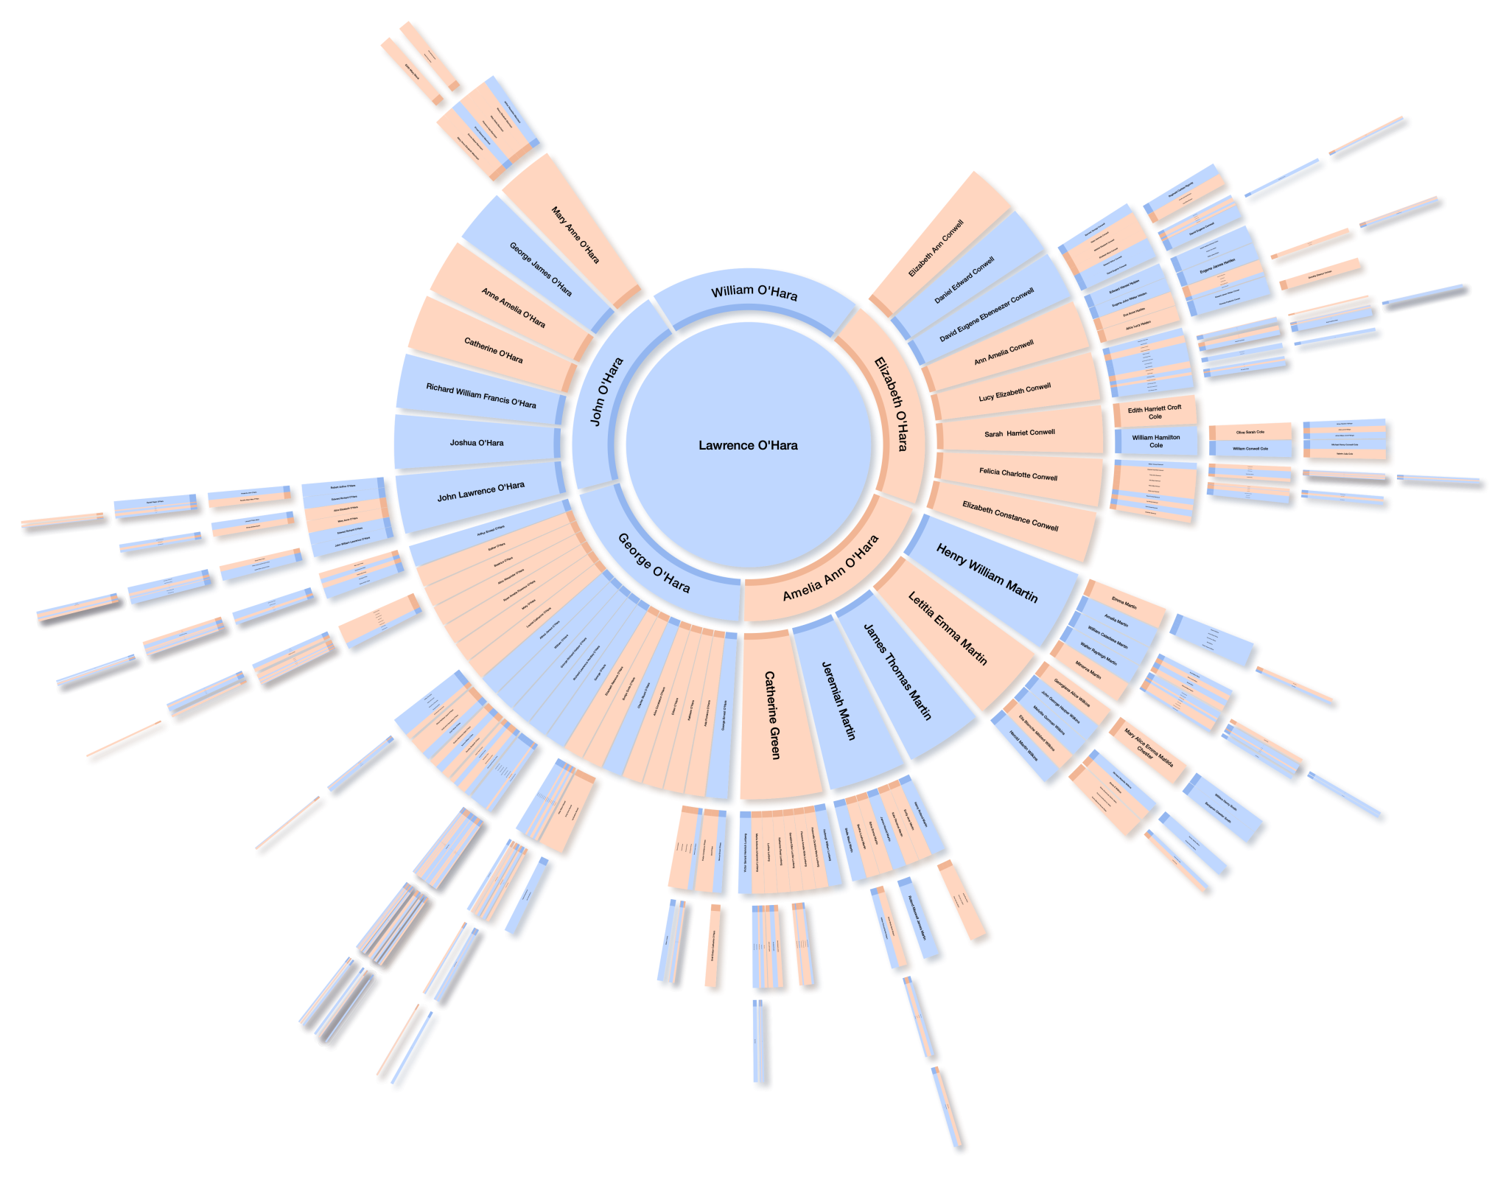
Lawrence O’Hara was born in Ireland in around 1770 and had four surviving children, John, Elizabeth, Amelia and George in India between 1808 and 1823.
This video shows where their descendants migrated to and were born over the following 200 years.

Slide 3
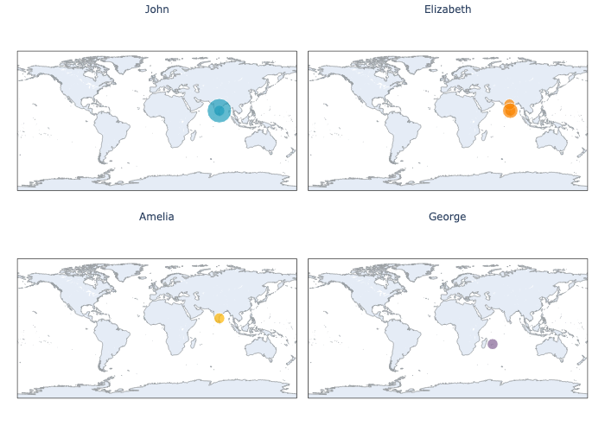
1800-1840

Slide 4
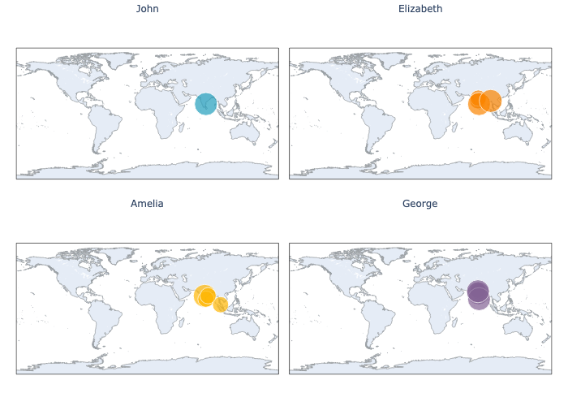
1840-1860

Slide 5
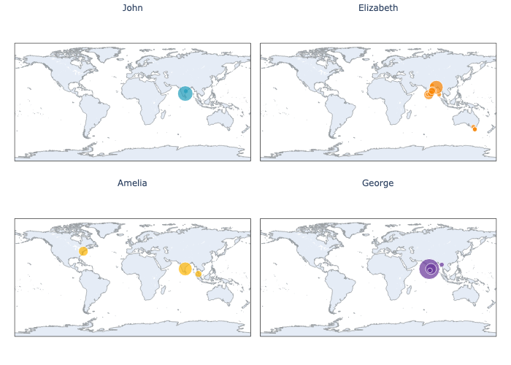
1860-1880

Slide 6
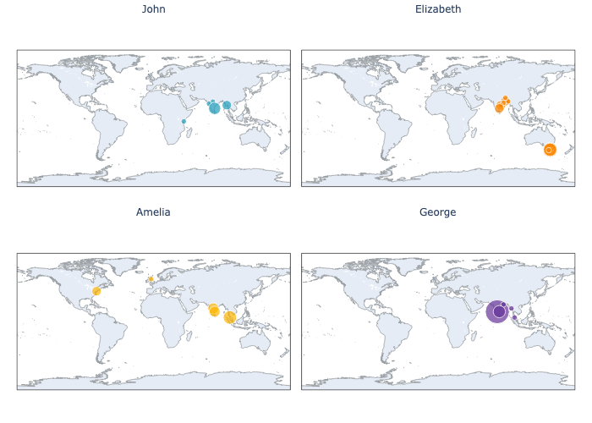
1880-1900

Slide 7
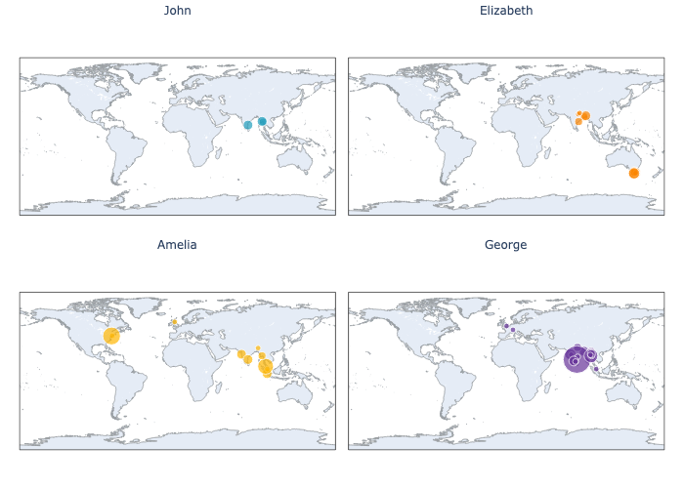
1900-1920

Slide 8
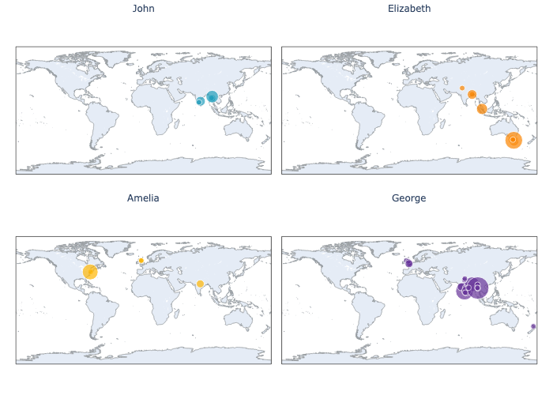
1920-1940

Slide 9
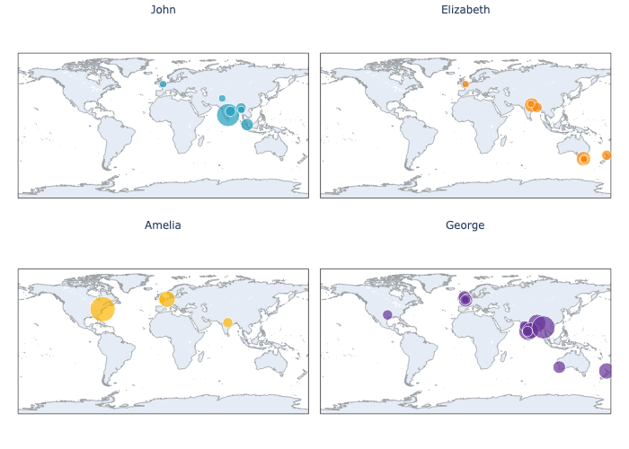
1940-1960

Slide 10
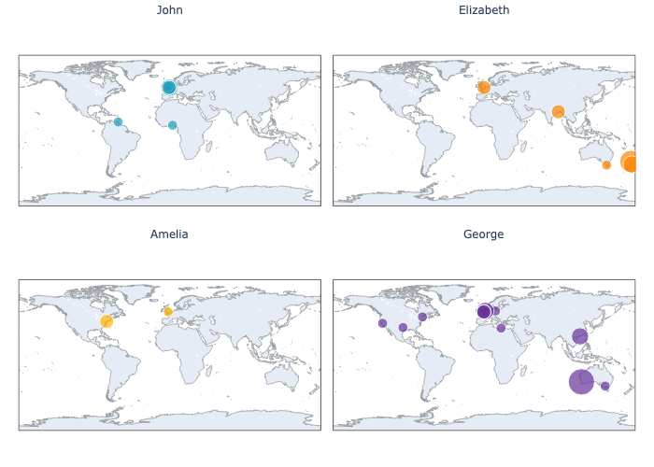
1960-1980

Slide 11
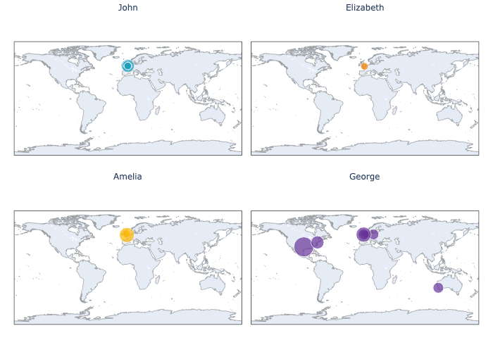
1980-2000

Slide 12
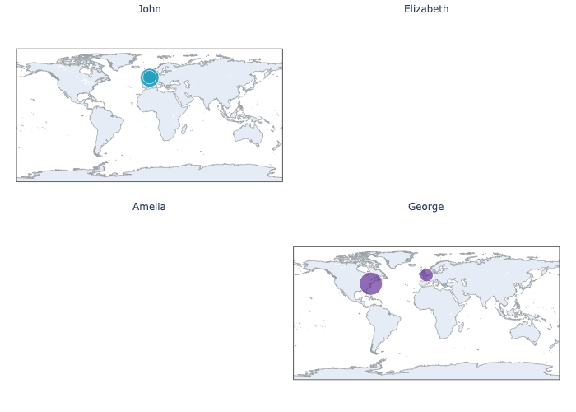
2000-2020

Slide 13
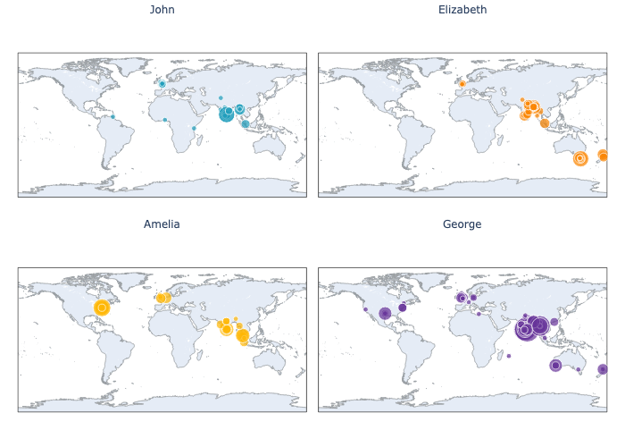
1800-2020

Slide 14
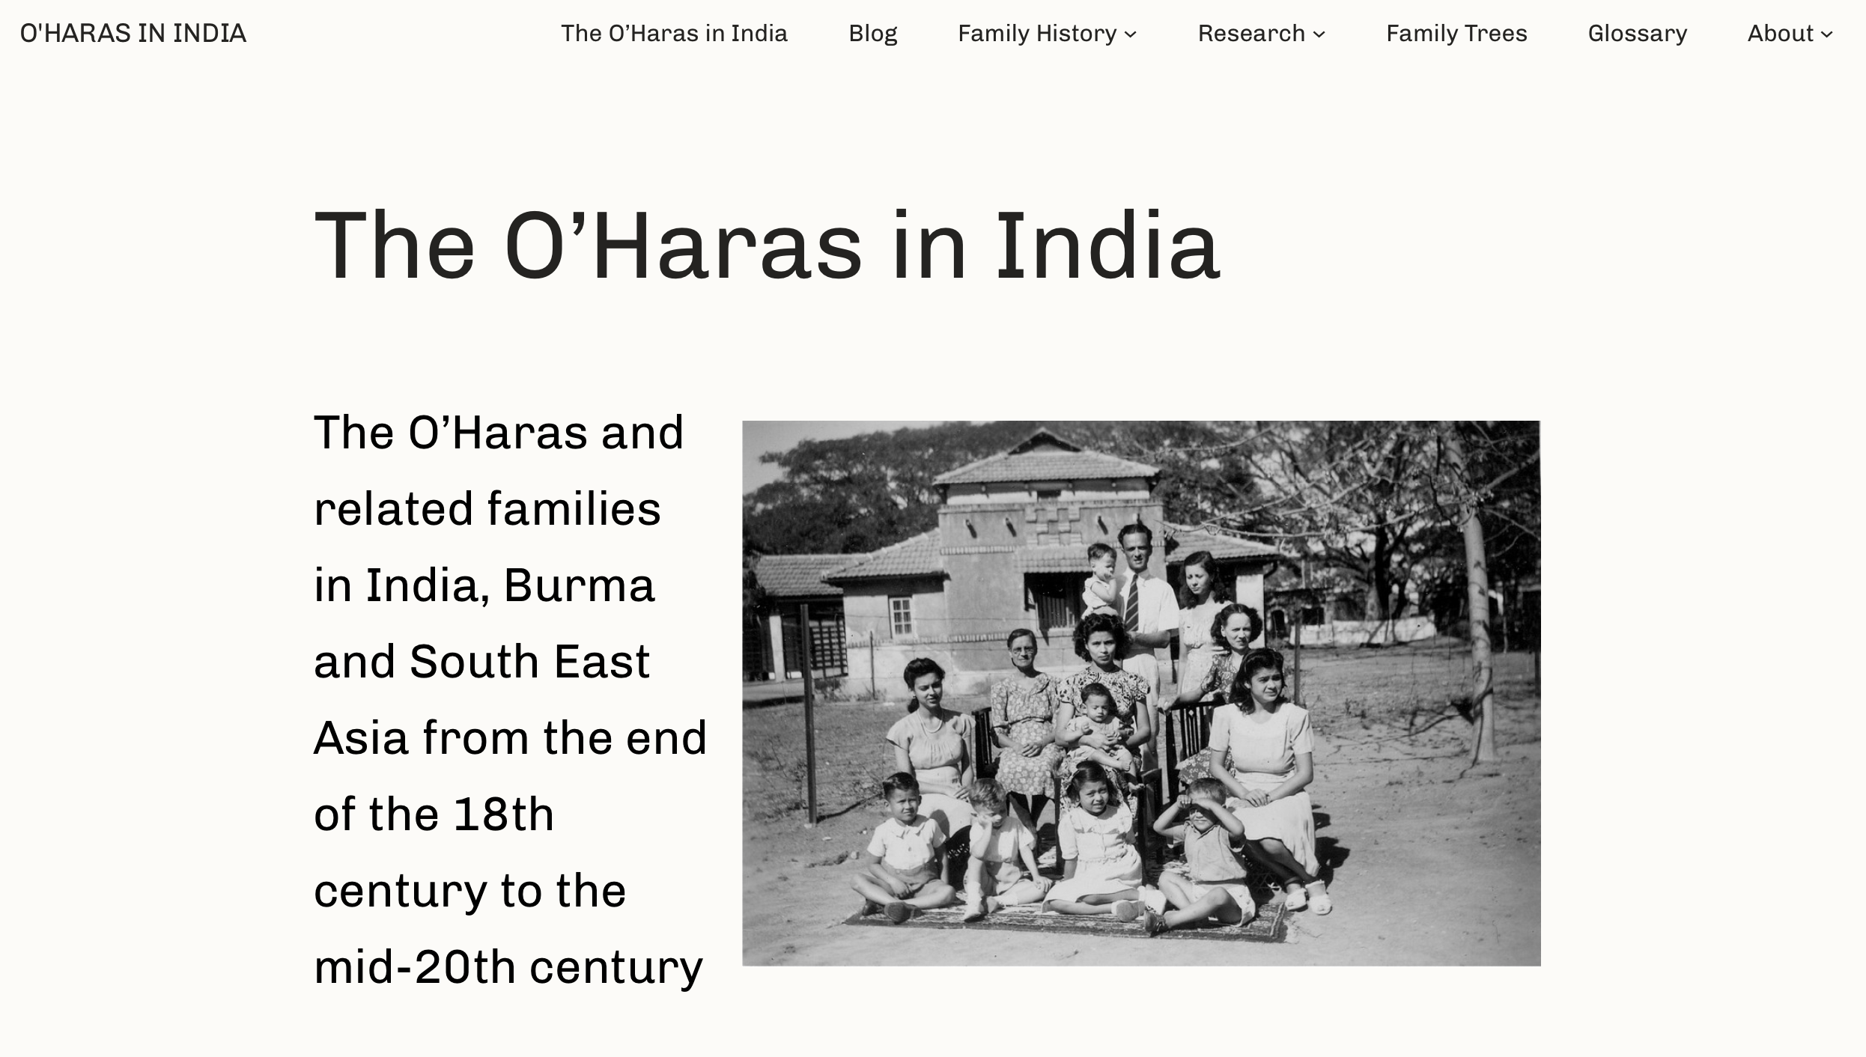
For more information visit
https://www.spuddybike.org.uk

